Slide 1
Argument Mining
Context Dependent Claims

Slide 2
Artificial Intelligence
"I have heard you hold the world record in debate competition wins against humans, but I suspect you have never debated a machine. Welcome to the future.”
IBM Project Debater
a.k.a. Miss Debater

Slide 3
What is Argument Mining?
Research area within Natural Language Processing (NLP)
Identification of Argument Structures

Slide 4
Background -
Inspired by competitive Speech and Debate
Research is a necessary part of preparation
In lieu of research, Briefs Packets are often purchased
High value potential

Slide 5
Scope - Context Dependent Claim
Project is a Proof of Concept
Goal: Extract Context Dependent Claims from text.
Context Dependent Claim:
Factual statement that directly affirms/negates a topic
May be a sentence or an independent clause within a sentence

Slide 6
Approach -
Gather Articles
Parse sentences
Over 300 Articles
Covering 0ver 30 topics
Sentence by Sentence
Clause by Clause
Extract clauses from sentences
CDC

Slide 7
TOPIC:
Europe should weaken its austerity measures to guarantee its citizens greater social support
SENTENCE:
Chartalists argue that deficit spending is logically necessary because, in their view, fiat money is created by deficit spending: one cannot collect fiat money in taxes before one has issued it and spent it, and the amount of fiat money in circulation is exactly the government debt -- money spent but not collected in taxes.
Context Dependent Claim
Deficit spending is logically necessary

Slide 8
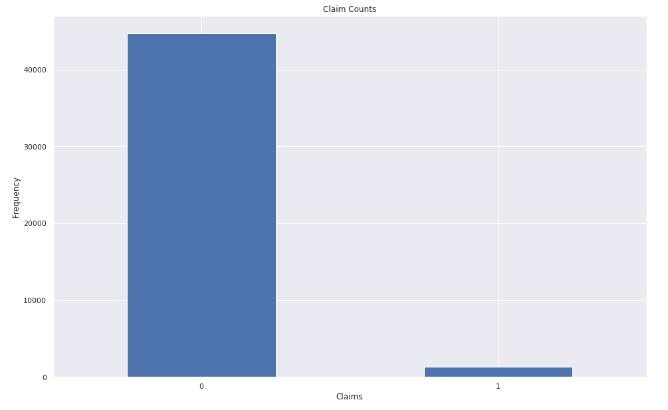
Class Imbalance
Steps taken to this point:
Trained NLTK sentence parser
Text cleaning

Slide 9
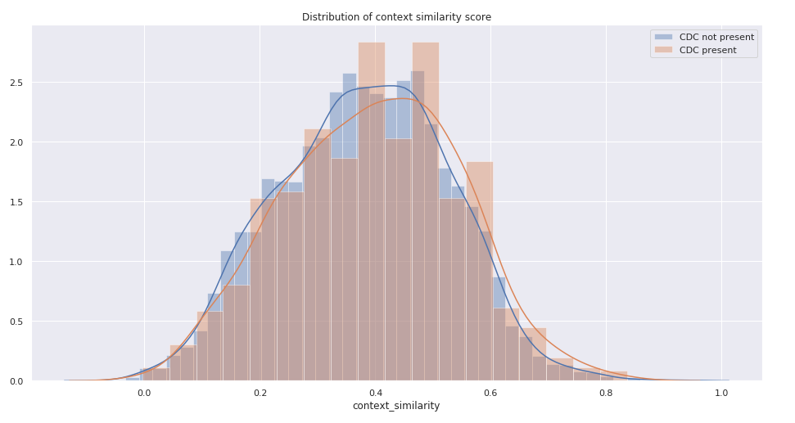
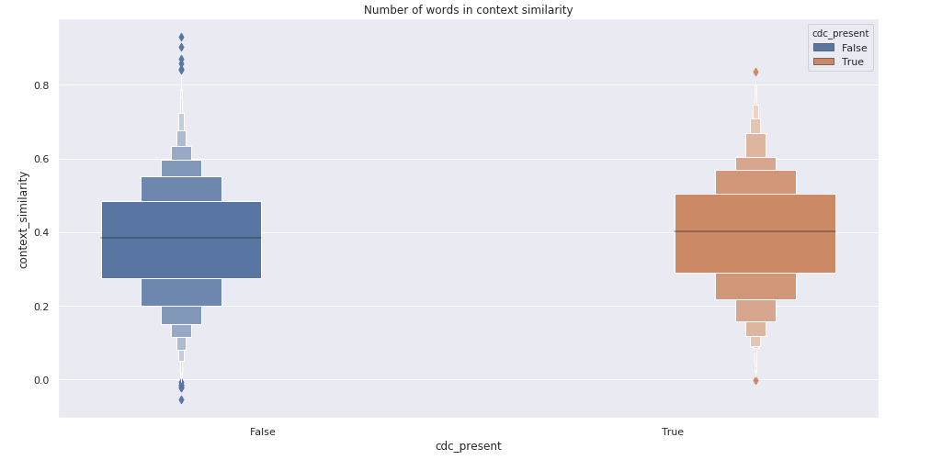
Similarity Score

Slide 10
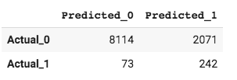
First Filter -- Select Candidate Sentences
Random Forest
LightGBM Boost
Recurrent Neural Network
Logistic Regression

Slide 11
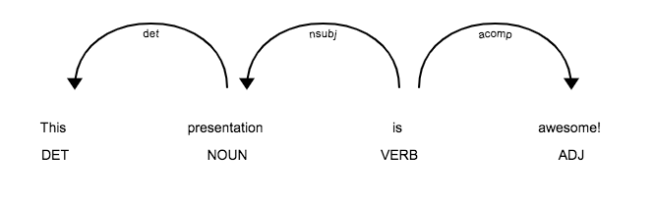
Sentence Deconstruction

Slide 12
Context Dependent Claim
Concise conclusive statement
Directly/contextually addresses the topic
Context is the sentiment of a topic’s evaluative object
Topic is NOT the context, it provides context

Slide 13
SENTENCE:
Chartalists argue that deficit spending is logically necessary because, in their view, fiat money is created by deficit spending: one cannot collect fiat money in taxes before one has issued it and spent it, and the amount of fiat money in circulation is exactly the government debt -- money spent but not collected in taxes.

Slide 14
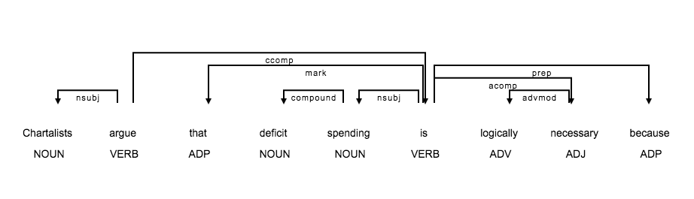
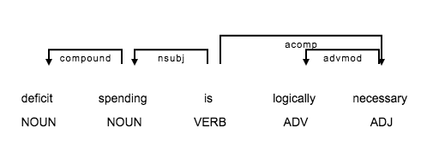
Clause v. CDC

Slide 15
Not ALL Clauses are extracted Equal
Extracted Clause 2
Fiat money is created by deficit spending
Remember what makes a Context Dependent Claim!
Extracted Clause 3
One has issued it and spent it

Slide 16
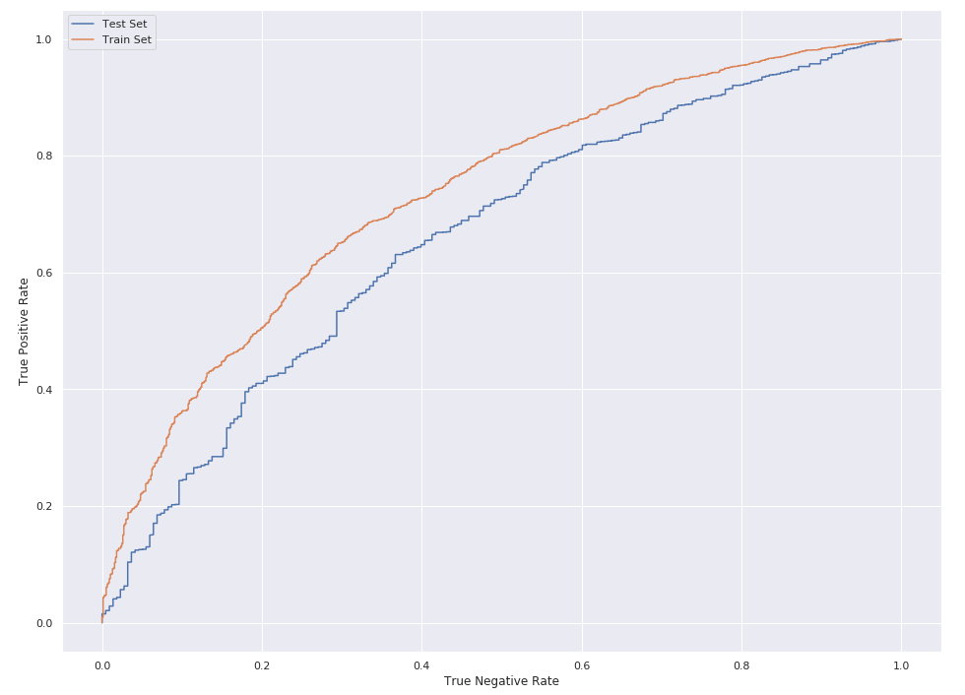
Model -- CDC Clauses
Random Forest
LightGBM Boost
Recurrent Neural Network
Logistic Regression

Slide 17
Next Steps
Review of Pipeline:
Began with 8749 sentences
Final extracted CDCs 832
Began with 988
Correctly Classified 60.6% of CDC containing sentences
Miss-Classified 35.8% of sentences
Review Data

Slide 18
Bad Base Truth CDC’s -
They tend to have an impact on the poorest segments of the population
In the case of federally funded aid, contributions have, in effect, crowded out any investment in the private sectors of many nations
Aims to correct the effects of past and present discrimination
If the foreign assistance is substantial enough, and lasts long enough, the capital stock rises sufficiently to lift households above subsistence
Social problems and personality disorders in young people

Slide 19
Good CDC’s Extracted from Sentences labeled “False” -
Restrictions on felon ownership of firearms did not violate this right (topic: right to bear arms)
God was a necessary metaphysical assumption demanded by circumstances (topic: atheism)
Resources exist for further population growth (topic: one child policy)
However, casino-style gambling is much less widespread (topic: gambling)
The imposition of equality is detrimental to society (topic: monarchy)

Slide 20
Promising Concept
But we can make it better...

Slide 21
Considerations
Sentence encoding (universal sentence encoder)
Encoding improvements (customize nlp pipeline)
Custom Models
Neural Network Implementation

Slide 22
QUESTIONS?

